Slide 1
F Group a Pedagogical Department of Phlogisten University
George Babcock, Head Wizard
Natalie Mays, Queen Bee
Chieko Azuma, Chinchilla Wrangler
Linda Brovarney, Mousketeer
Cynthia Pekow, Chief of Chocolate Consumption

Slide 2
Goal
IACUC members completing this module will develop an understanding of the value of facility inspections as part of a high quality program of animal care and use

Slide 3
Objectives: Upon completion of this module, participants will be able to:
1. Provide examples of animal welfare and health concerns that may be discovered and describe how you would address these concerns
2. Describe regulatory requirements for facility inspection, to include
A. Participants
B. Frequency of inspections, sites included
C. Reporting requirements
3. Differentiate Significant versus Minor deficiencies
4. Indicate different component areas of facilities and concerns related to these areas
5. Identify occupational health and safety concerns
Notes:
Discuss the importance of collegial interactions with animal care and research staff during facility inspections

Slide 4
Watch this before proceeding with the training: Link to NJABR presentation - https://www.youtube.com/watch?v=TnUOp2svQRY
Bring questions for a 15 minute group discussion.
Notes:
Formative, concept. This video from NJABR should be viewed prior to proceeding with this program.

Slide 5
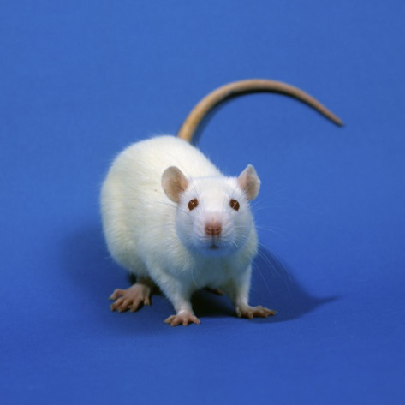
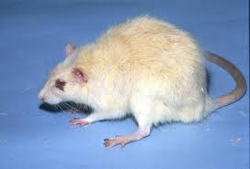
Describe the differences between these two animals
Notes:
Formative Assessment for Objective 1: Think – pair- share. Normal rats should be active, have a smooth and shiny haircoat, bright clear eyes, and good body mass.
Signs of disease or discomfort: huddles in corner, hunched posture, scruffy haircoat (due to dehydration
or lack of grooming), feels cool to the touch, avoids cagemates, diarrhea (i.e., sticky feces), pale appearance to eyes, nasal/ocular discharge, porphyrin staining (red or brown staining around eyes or nose), coughing, sneezing, chattering, vocalizations, decreased appetite, weight loss, respiration
increased or labored.

Slide 6
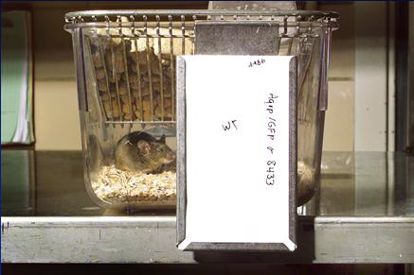
What is wrong with this picture?
Use this reference:
Guide for the Care and Use of Laboratory Animals
Page 75, Population Management
Notes:
Objective 1. Formative assessment, technology enhanced learning activity, 6 minutes. Purpose to demonstrate a concern with animal identification as described in the Guide

Slide 7
As a team, find the resources to answer these questions
References:
Animal Welfare Act Regulations
Section 2.31 (c) (3)
Public Health Service Policy
Section: Semiannual Program Reviews and Facility Inspections
Describe regulatory requirements for facility inspection, to include
A. Participants: how many and who are they?
B. Frequency of inspections, sites included
C. Facility inspection findings are reported to whom?
Notes:
Objective 2: Formative: Technology enhanced learning. Expected 10 minutes. Basic LOCs, fact based.

Slide 8
OLAW definition: OLAW E2. How does the IACUC distinguish between significant and minor deficiencies? USDA definition concurs. Significant Deficiency: Is or may be a threat to the health or safety of animals. Minor Deficiency: A problem for which an immediate solution is not necessary to protect life or prevent distress.
Notes:
Objective 3.Formative. Technology enhanced collaborative learning. Link provided to definition with examples. Point out that USDA terminology differs: Major vs Minor

Slide 9
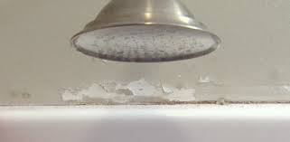
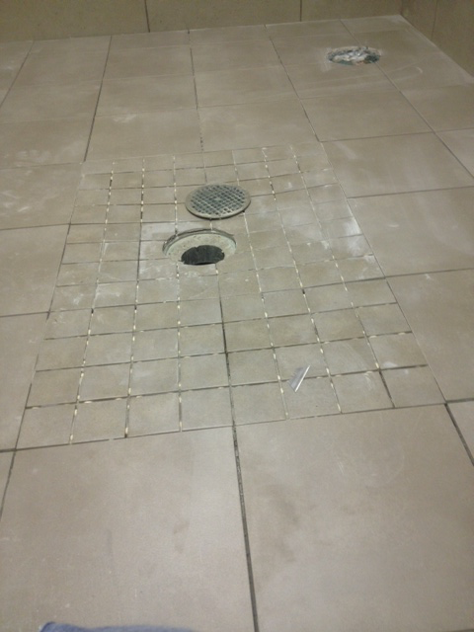
Significant?
A. Animal facility emergency
shower.
C. Animal room drain.
B. Frayed cord in active use with a large animal respiratory ventilator.
Notes:
Formative, Objective 3: Think – pair- share. Post-its held up to show their group consensus (set of 3 photos) Two minutes

Slide 10
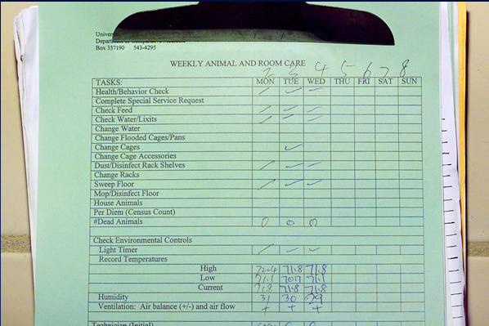
Today is Saturday the 7th. What concerns do you have?
Notes:
Formative. Objective 4, component areas/concerns. Think pair share, 2 minutes. Idea is to emphasize the importance of records and who is responsible and what consequences can come from incomplete documentation.

Slide 11
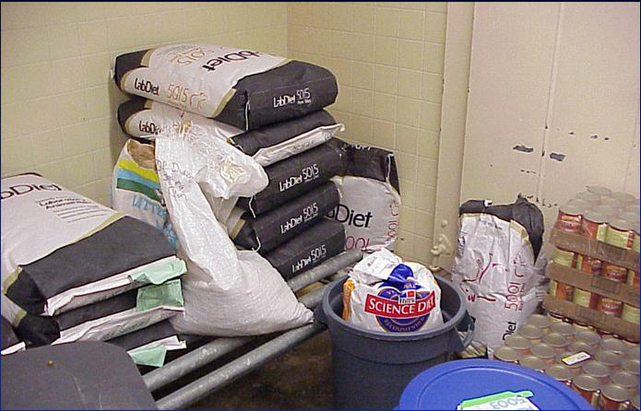
What is wrong with this picture?
Notes:
Formative for Objective #4 Indicate different component areas of facilities and concerns related to these areas. Activity: peer or collegial instruction. Four minutes. Goal is to bring out experienced persons’ knowledge about specifics such as feed storage requirements. 5 minutes.

Slide 12
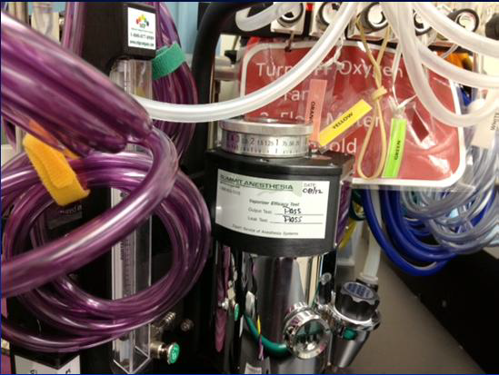
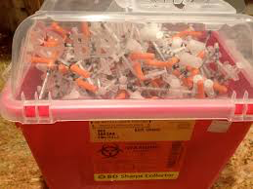
A veterinary technician faints while working in animal surgery, and stumbles into the sharps box. Discuss what occupational health concerns must be addressed
Notes:
Formative Objective 5. Activity = case-based learning. 5 minutes. Idea is to bring out safety concerns when doing inspections. Ask each group to cite 3 health concerns raised.

Slide 13
When you see this during a facility inspection, what are your concerns and how would you address them?
Notes:
Summative assessment for animal health and welfare. Each table has two copies of a photo illustrating a concern. Think – pair- share. Three minutes to discuss, then share with the group. 8 minutes total. Goal is to identify problems and what should be done, ie who to bring in

Slide 14
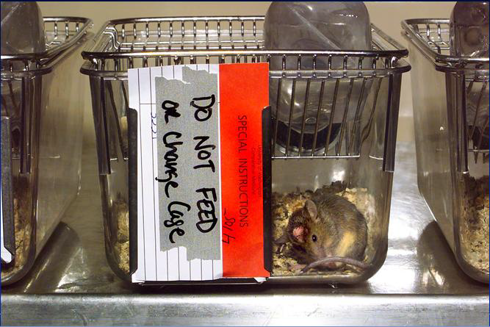
When you see this during a facility inspection, what are your concerns and how would you address them?

Slide 15
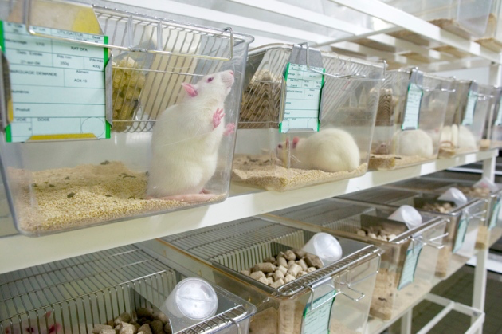
When you see this during a facility inspection, what are your concerns and how would you address them?

Slide 16
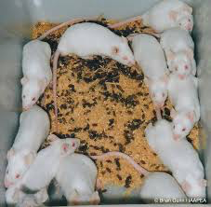
When you see this during a facility inspection, what are your concerns and how would you address them?

Slide 17
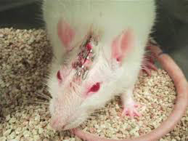
When you see this during a facility inspection, what are your concerns and how would you address them?

Slide 18
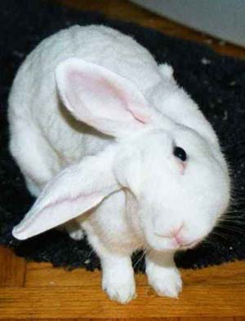
When you see this during a facility inspection, what are your concerns and how would you address them?

Slide 19
Phlogisten University has a PHS assurance, and uses USDA covered species. What is the minimum number of IACUC members required to participate in their facility inspections?
A) 1
B) 2
C) 3
D) 4
Notes:
Summative for Objective 2. Clicker personal response system. One minute. LOC, fact based.

Slide 20
Assemble your Dream Team for facility inspection... Who would you choose and why? Examples include:
Attending veterinarian
IACUC Chair
Scientist IACUC member
Nonaffiliated member
Nonscientist member
Cage-wash technician
Animal Care Technician
Institutional Official
Animal Rights Activist
IACUC administrator
Institution’s legal counsel
Research technician
Clinical veterinarian
Vivarium supervisor
Principal investigator
Biosafety officer
Industrial hygienist
Notes:
Summative for objective 2: Three minute group discussion, then make a consensogram. One member from each team places a sticker (or places a mark) by the title of the persons you want on your dream team. Goal consideration of different strengths added by having different perspectives on the team.

Slide 21
Identify 3 different areas of focus when inspecting these sites
1. Animal housing room
2. Cage wash
3. Necropsy
4. Feed storage
5. Survival surgery
6. Loading dock
7. Transport vehicles
8. Carcass storage
9. Procedure room
10. Cage and equipment storage
Notes:
Summative for objective #4: Think pair share report out. Each table assigned 2 rooms. Make a sticky note with 3 items for each room listed. Stand and describe for each room what they would look for. 5 minutes.

Slide 22
That’s all for now, folks!

Slide 23
PLACE HOLDER Slides that appear after this have not yet been incorporated into the program

Slide 24
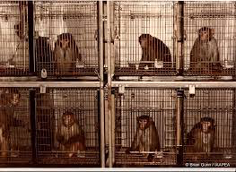
Are there health or welfare concerns?

Slide 25
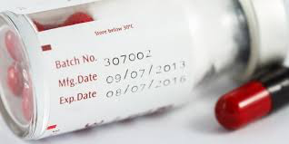
What is the potential animal health or welfare concern?

Slide 26
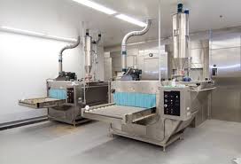
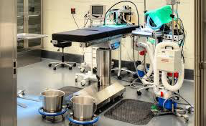
Misc. photos

Slide 27
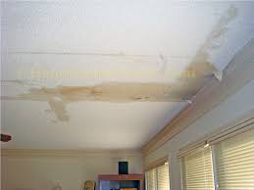
Misc. photos

Slide 28
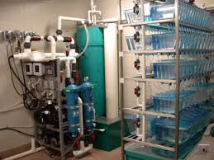
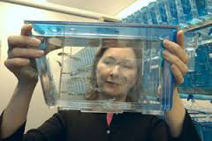
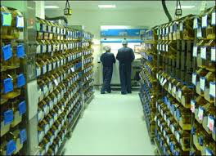
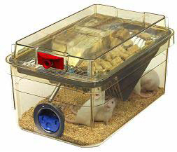
Misc. photos
Notes:
Objective 4 Formative:

Slide 29
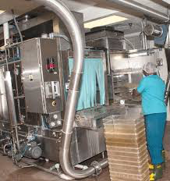
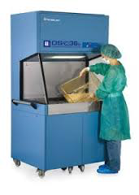
Misc. photos

Slide 30
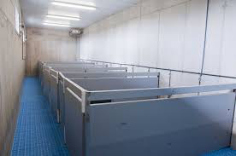
Misc. photos

Slide 31
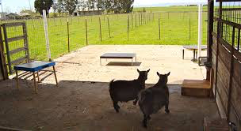
Misc. photos

Slide 32
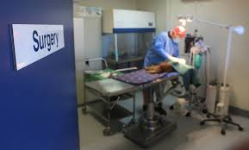
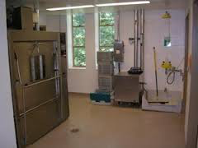
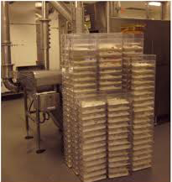
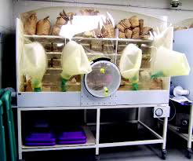
Misc. photos

Slide 33
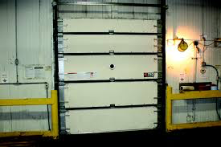
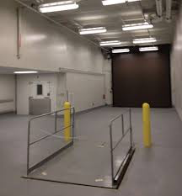
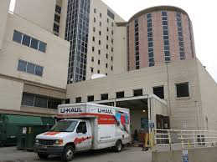
Misc. photos

Slide 34
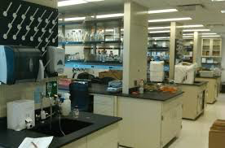
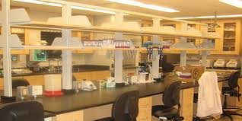
Misc. photos

Slide 35
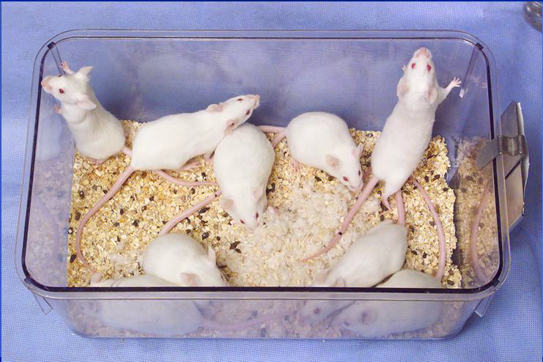
Misc. photos

Slide 36
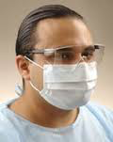
You see this man dumping dirty rodent cages in the cage-wash area. What might be the reasons he would wear this PPE?
Notes:
Formative for objective #5.

Slide 37
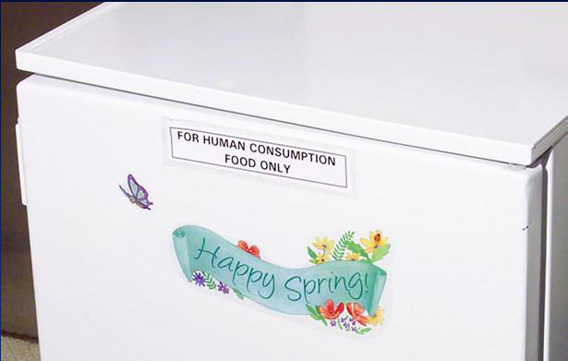
What are the concerns with storing monkey chow in this refrigerator?

Slide 38
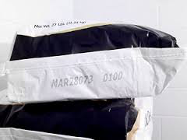
What do these numbers mean on a feed bag? Why are they important to animal welfare and health?

